Slide 2
Texture tomography

Slide 3
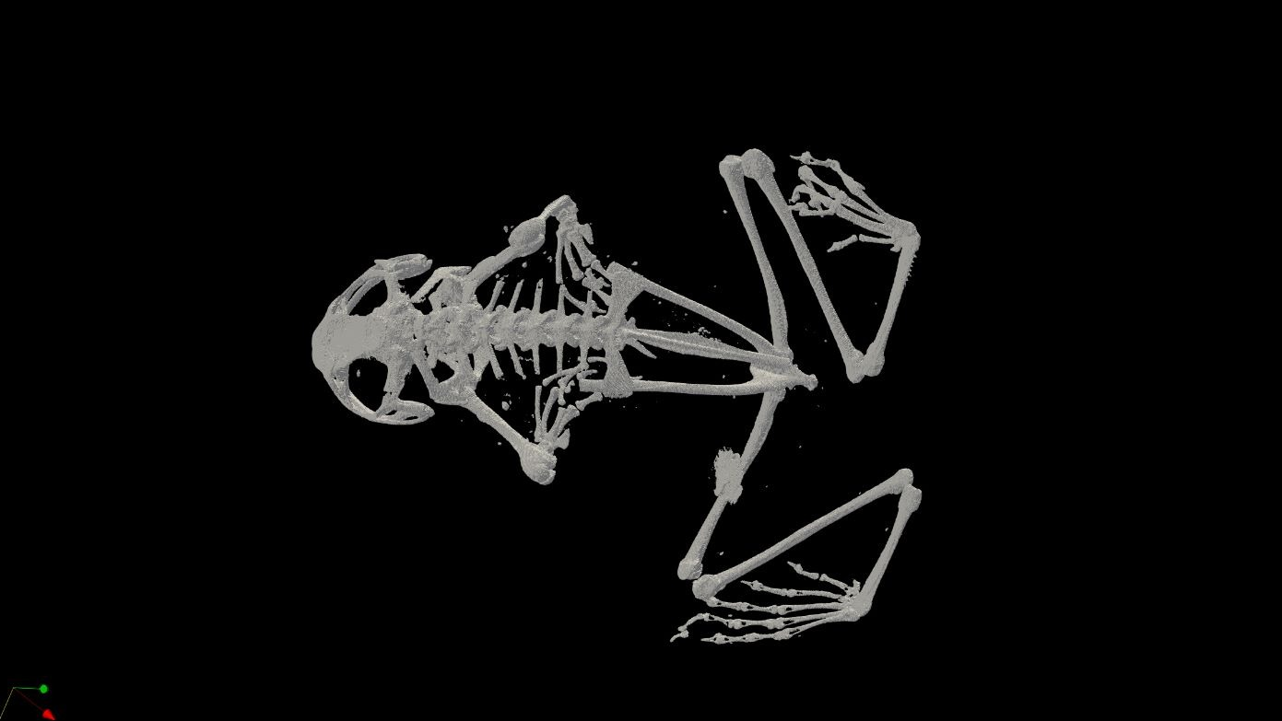

Slide 4
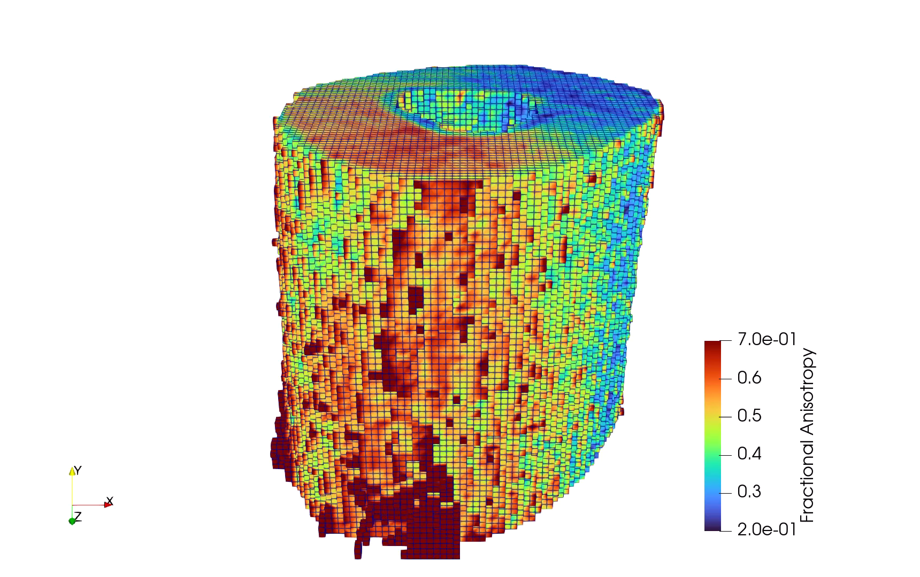
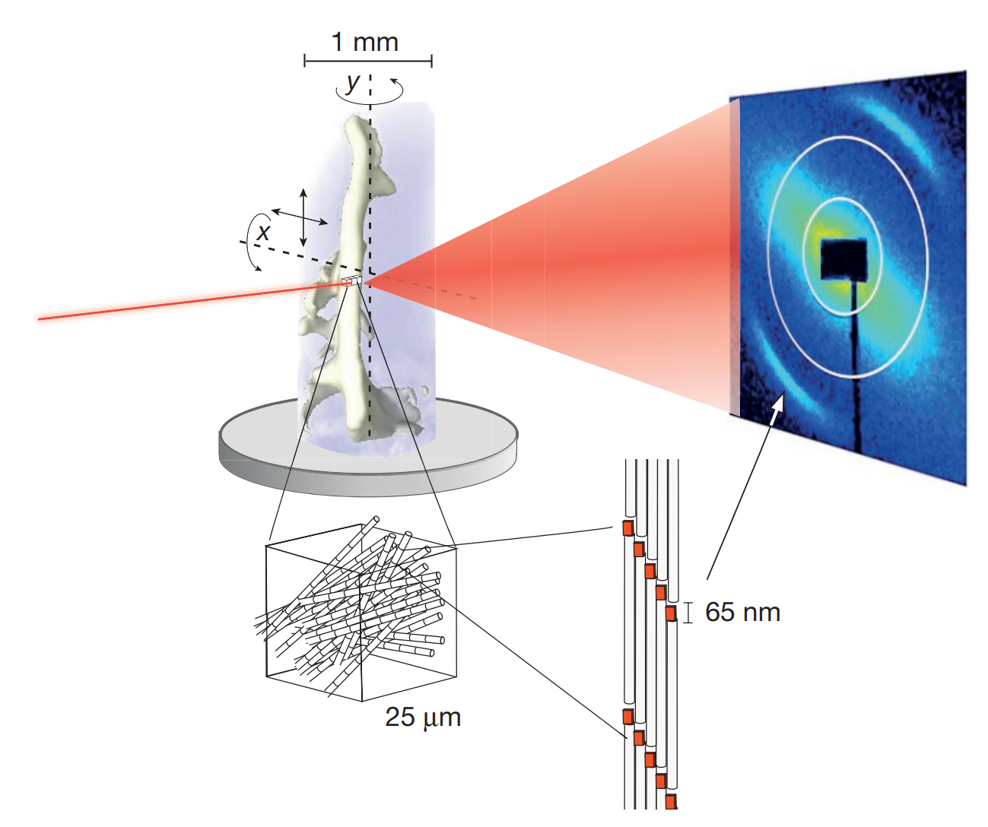
Small angle x-ray scattering tensor tomography
[M. Liebi et al., 2015]

Slide 5
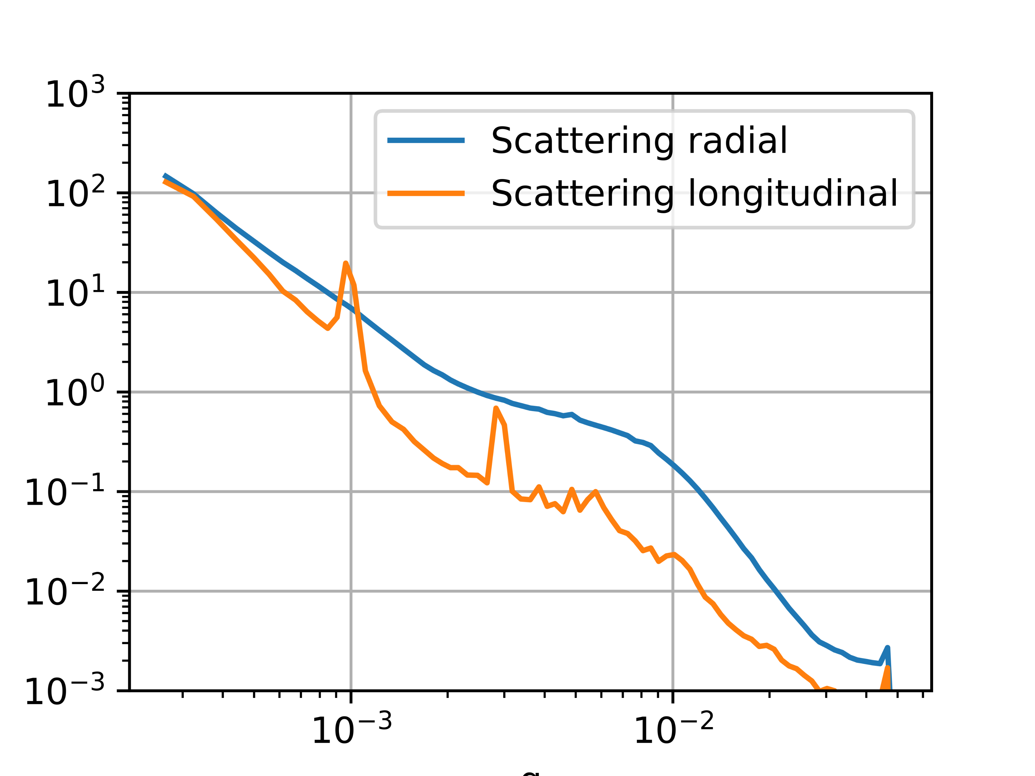
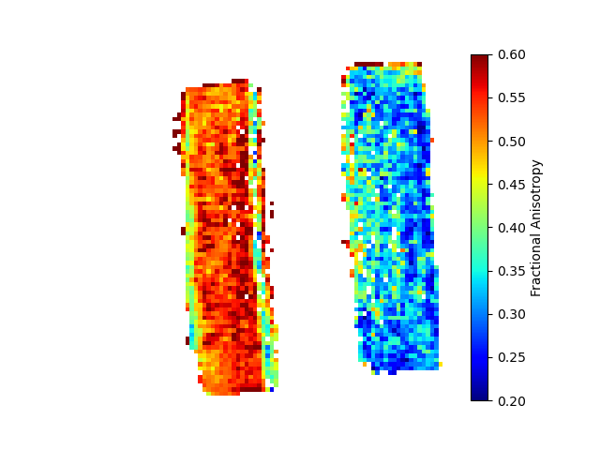
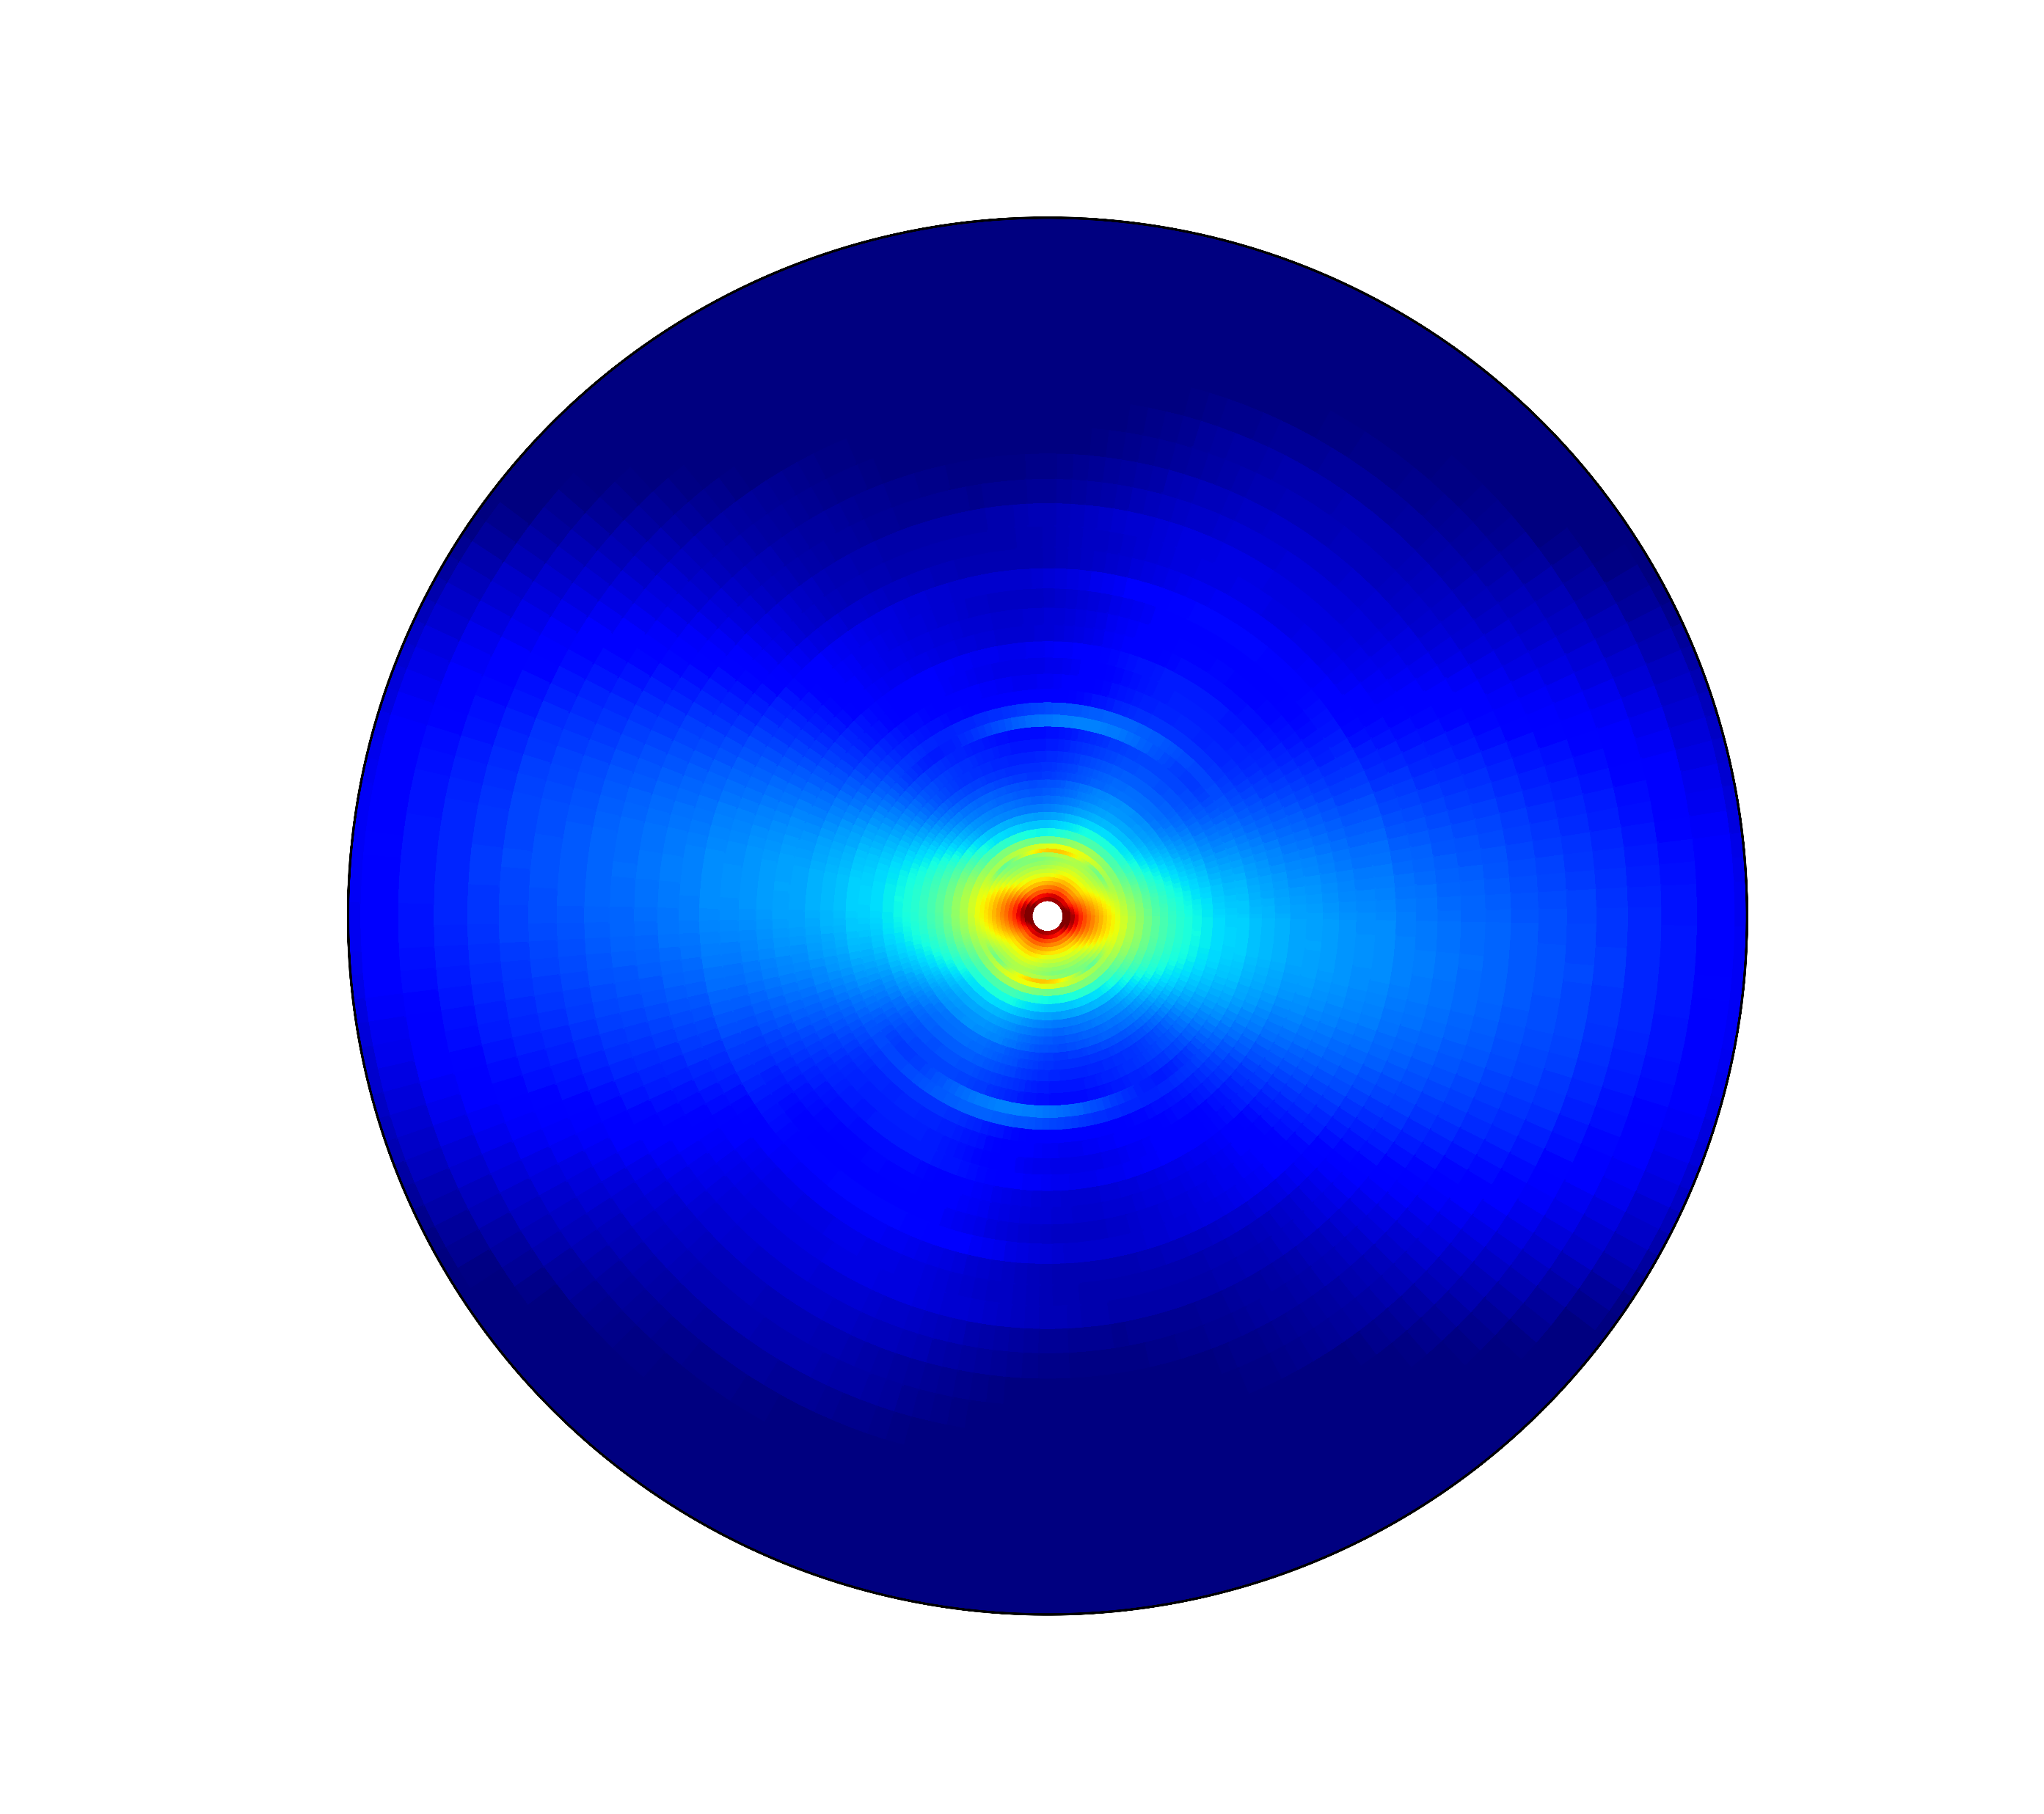
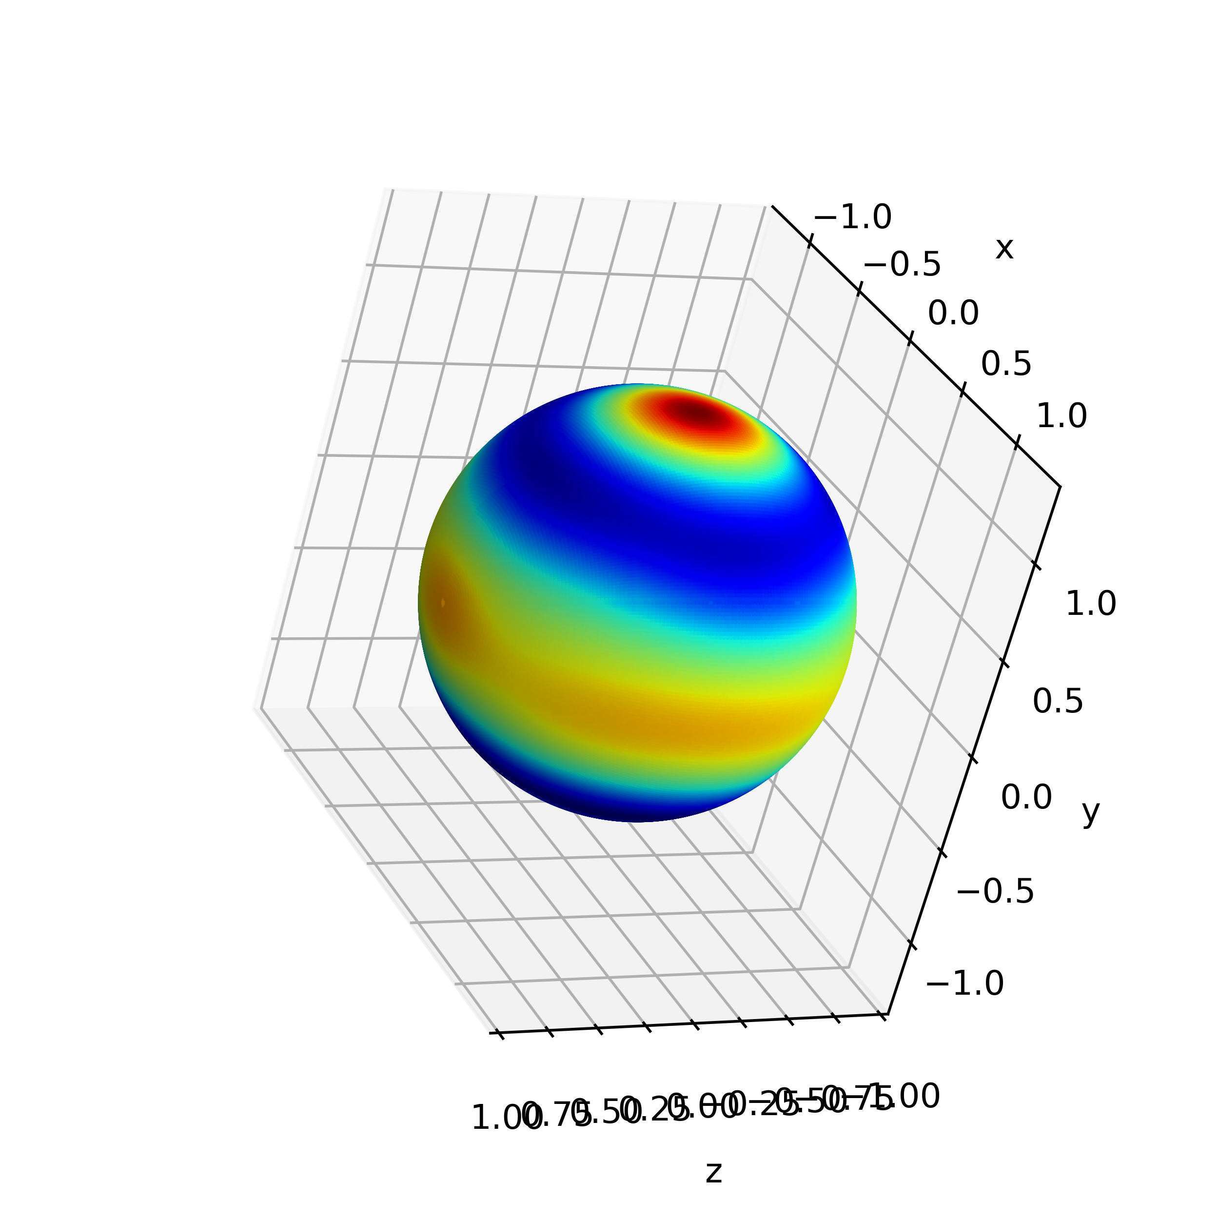
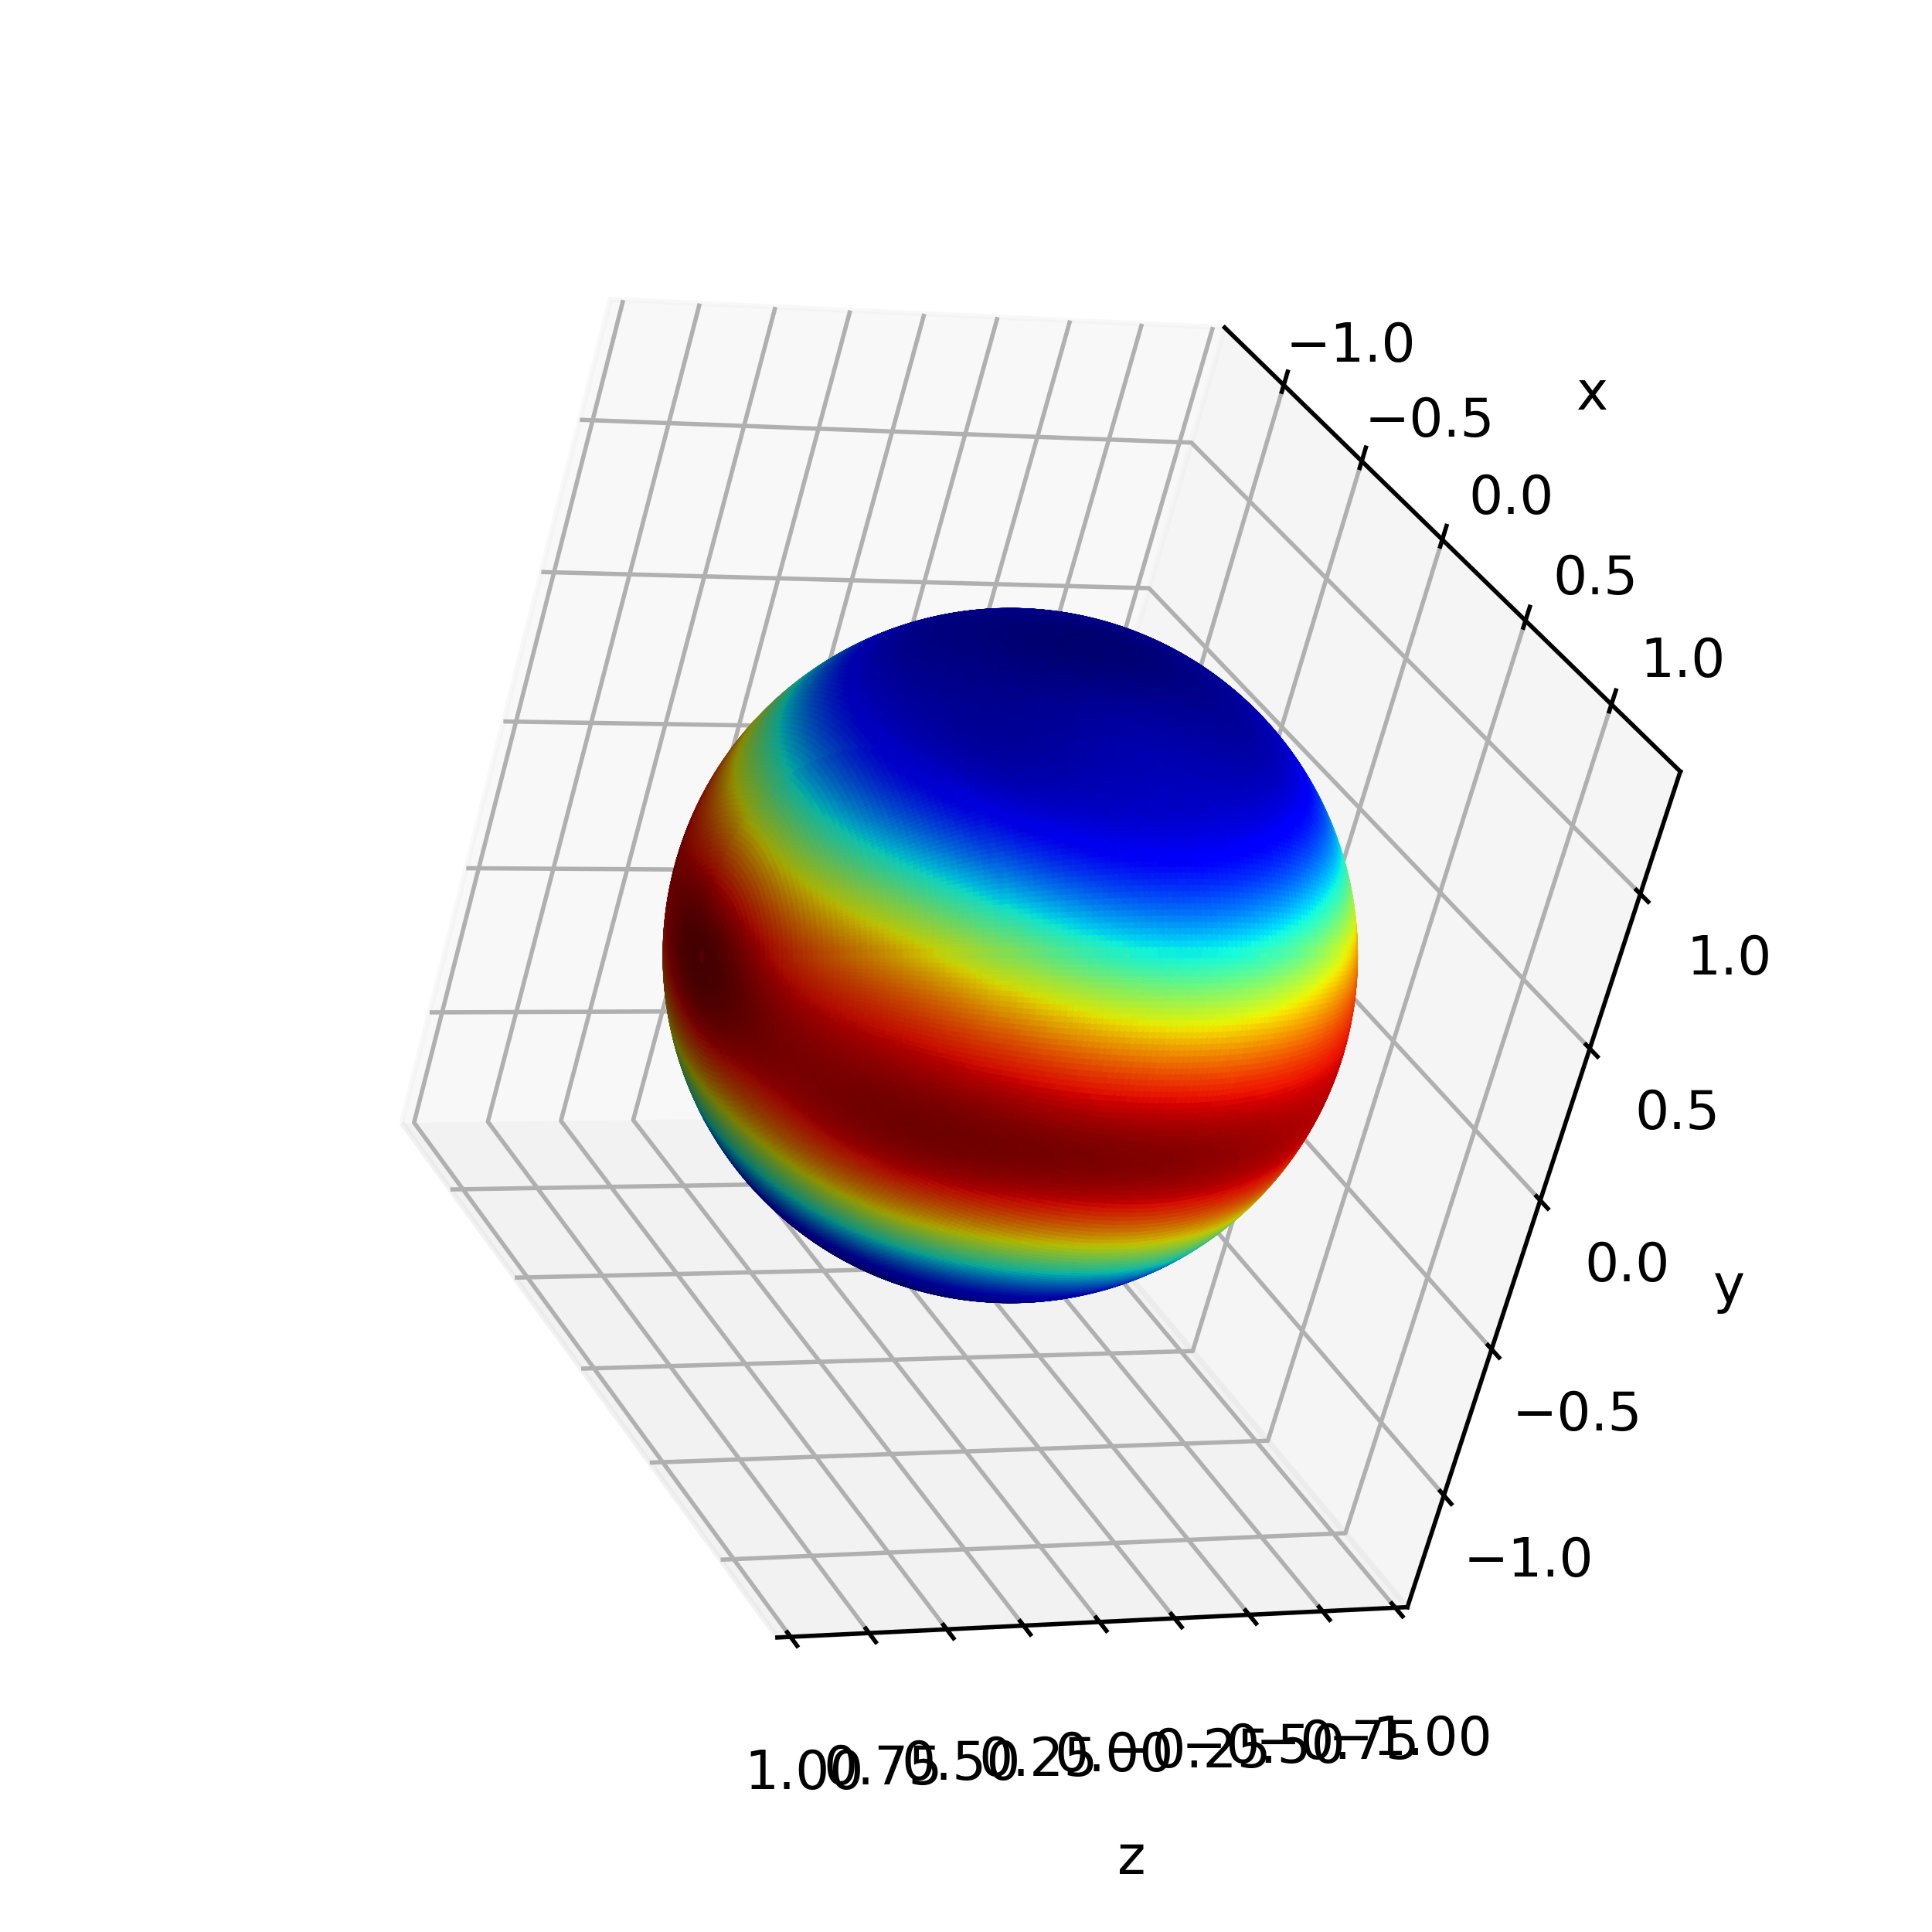
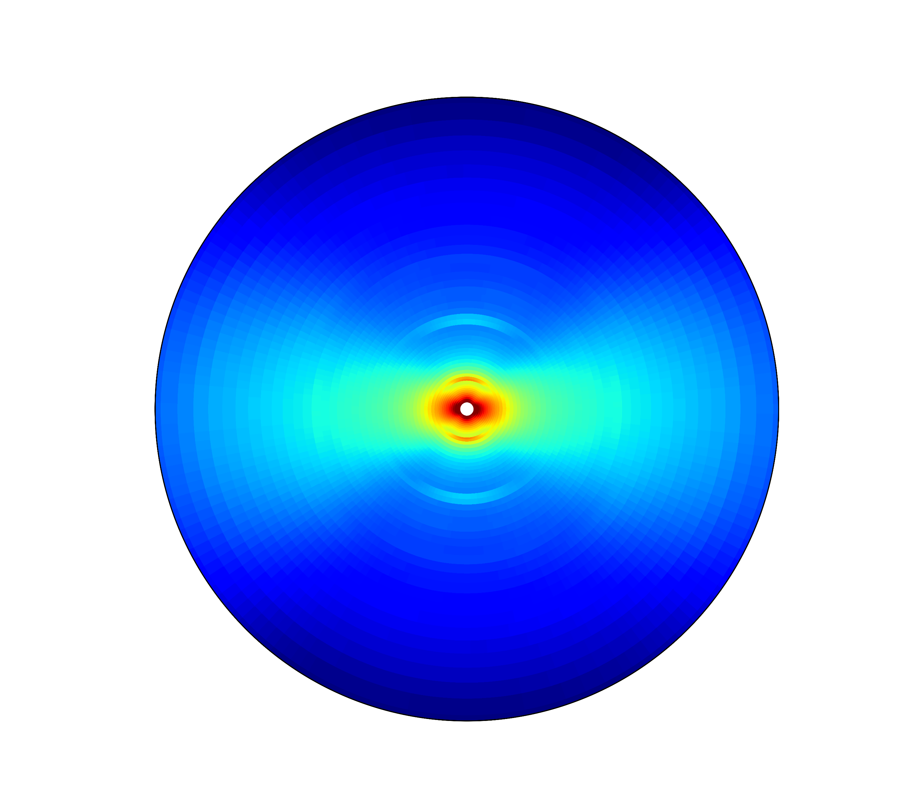
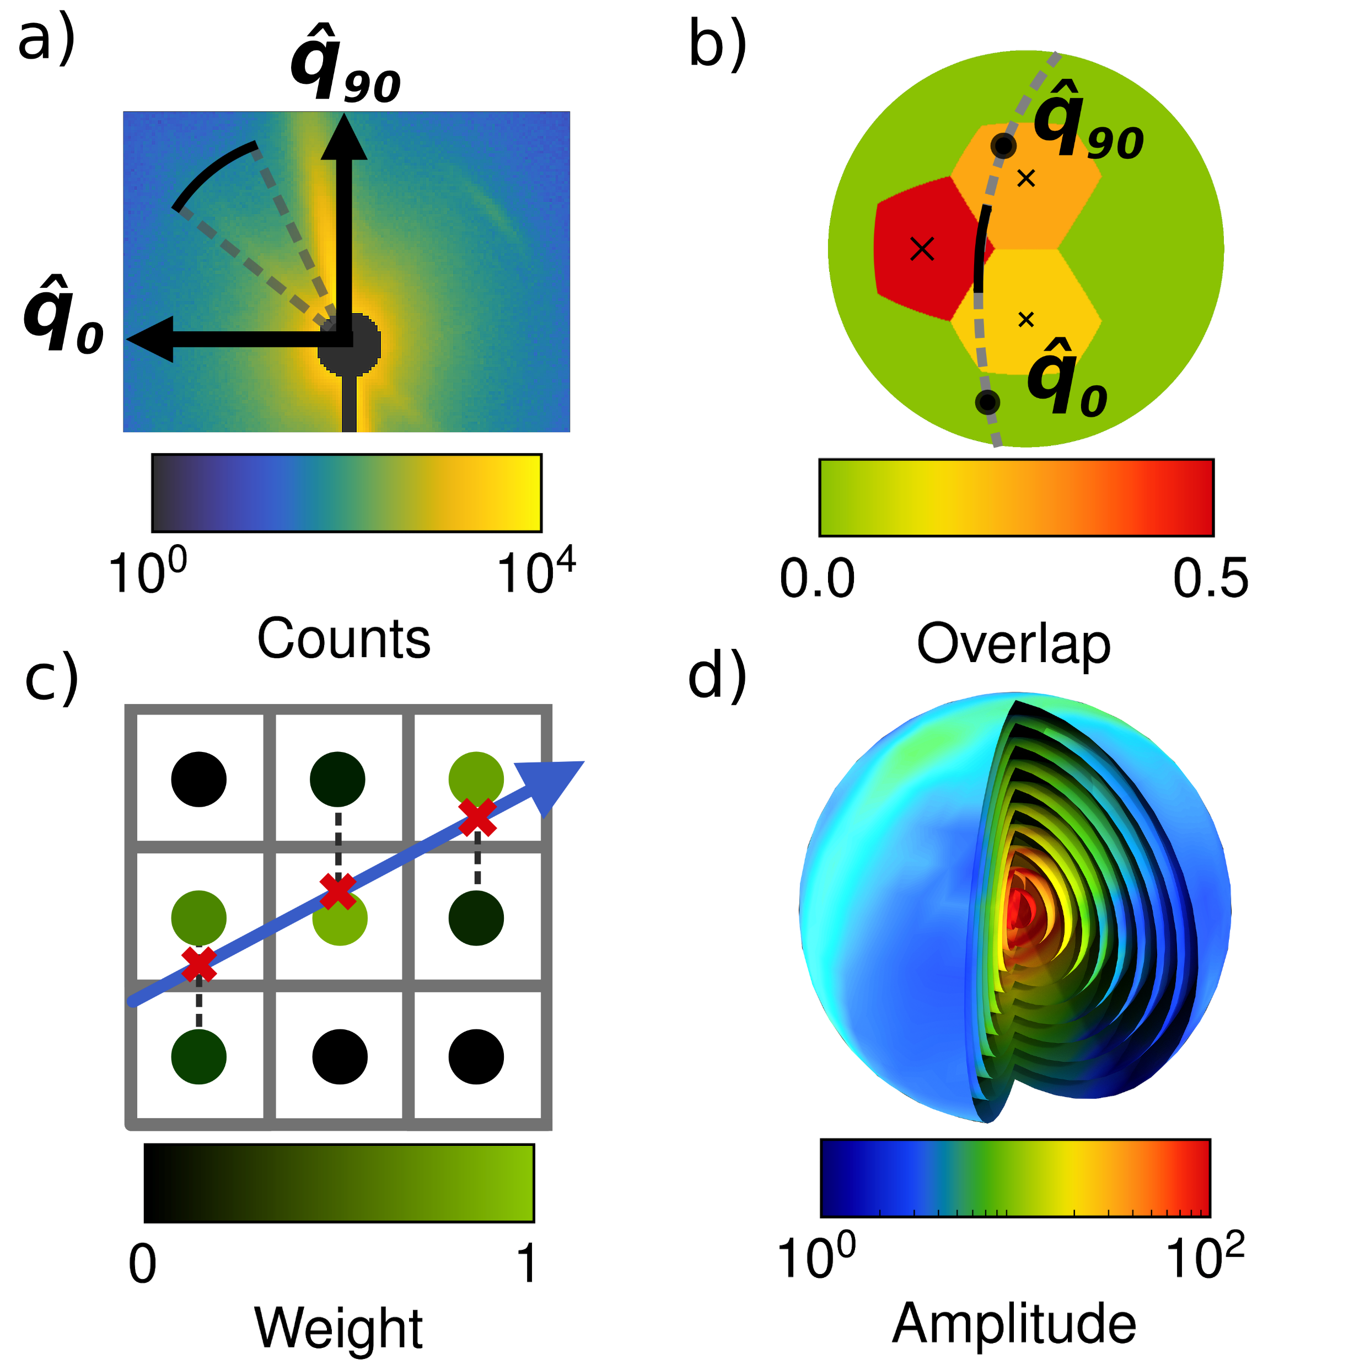
Diffraction patterns
Pole figures
Reciprocal space map

Slide 6
Blocked by diffractometer
X-ray beam
X-ray beam

Slide 7
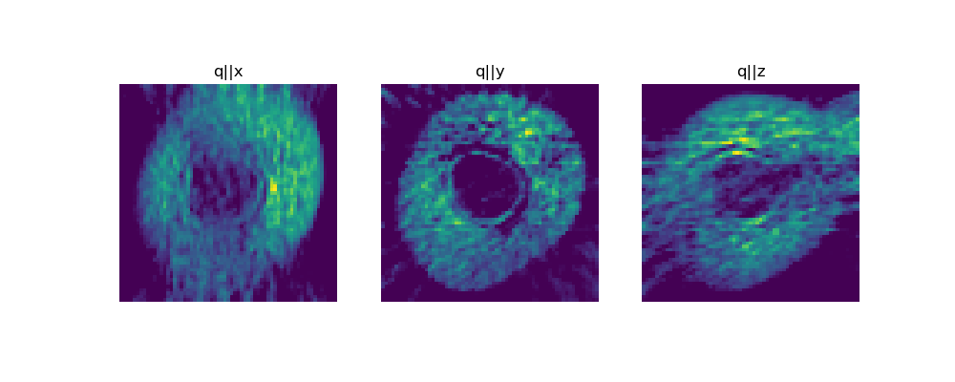
The problem with tensor-tomography:
In general; all 2D-projection directions need to be measured.
2-circle diffractometers are not available at most XRD-CT BLs.
Difficult alignment and data processing
Always 3D-tomography; no slice-by-slice.
In practice some directions are always blocked by the sample-mount and diffractometer geometry.
Missing projections lead to missing-wedge artifacts in certain scattering-directions; easy to misinterpret as sample features.
y
z
x
z
z
z
x
x
x

